Slide 1
Azure Data Platform End-to-End Implement a Modern Data Platform Architecture
Fabio Braga
Cloud Solution Architect – Data Platform
fabio.braga@microsoft.com

Slide 2
Begin with the end in mind

Slide 3
Course Objectives
We will understand Cloud and Big Data concepts and technologies used to solve the most common advanced analytics problems
We will understand the role of Microsoft Azure data services in a modern data platform architecture
We will look at individual Azure Data Services and use them to implement a modern data platform reference architecture
We will have a ARM template of a data platform that will enable us to solve most of our data challenges

Slide 4
Important Reminder
The modern data platform architecture proposed in this course aims to help with your technology decisions when architecting data solutions in Azure.
The Azure services covered in this course are only a subset of a much larger family of data services. Some real-world data scenarios may require the use of services not included in this course.
This course does not replace in-depth training on each Azure service covered today.
Some concepts presented in this course can be quite complex and you may need to seek for more information from different sources.

Slide 5
Modern Data Platform Reference Architecture

Slide 6
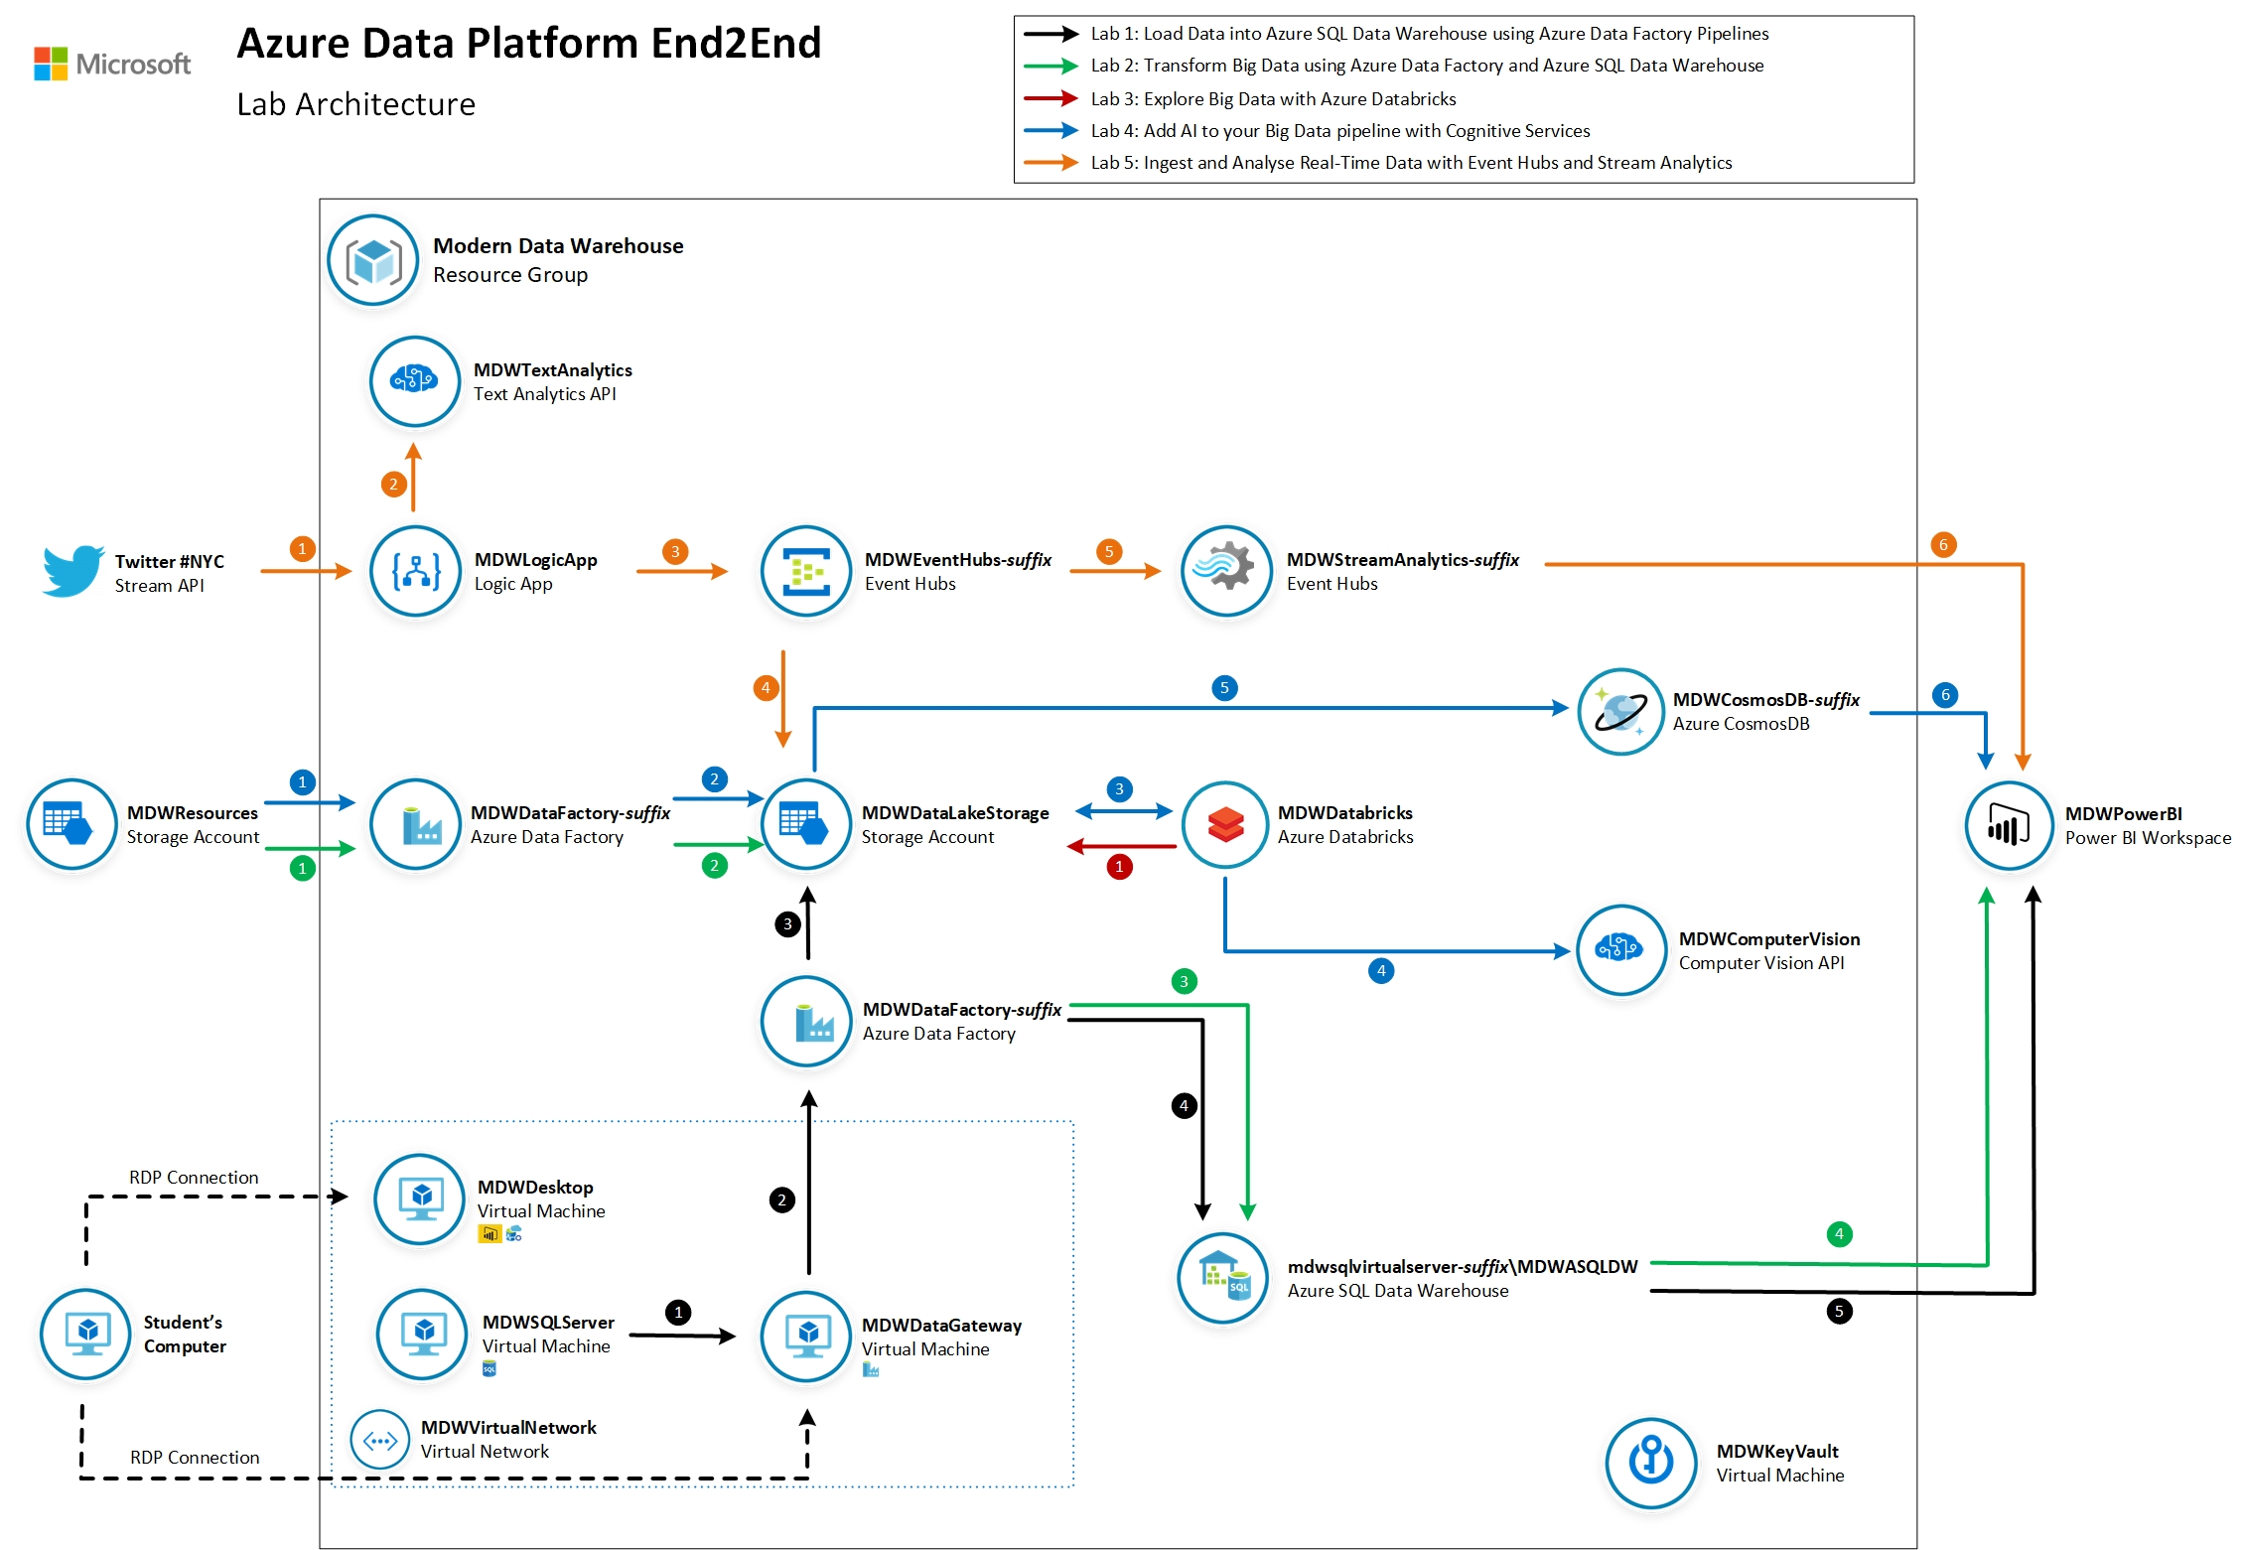
Lab Guide

Slide 7
The modern data world out there

Slide 8
I tried to understand it, but…
No-SQL
Databricks
Storm
Data Catalog
IoT
PaaS vs IaaS
Hadoop
Power BI
Streaming
Deep Learning
Machine Learning
SMP vs MPP
Predictive
Data Mart
ETL vs ELT
Prescriptive
Data Visualisation
Data Warehouse
Data Lake
Master Data
Big Data
Data Factory
Cloud vs On-prem
Data Quality
Velocity, Variety and Volume
Spark
AI
Semantic Layer

Slide 9
The modern data estate
LOB
CRM
Graph
Image
Social
IoT
Hybrid
Operational databases
Operational databases
Data warehouses
Data warehouses
Data lakes
Data lakes
Reason over any data, anywhere
Flexibility of choice
Security and performance

Slide 10
The Microsoft offering
LOB
CRM
Graph
Image
Social
IoT
Hybrid
Easiest lift and shift with no code changes
SQL Server
Azure Data Services
Industry leader 4 years in a row
Operational databases
Operational databases
70% faster
#1 TPC-H performance
Data warehouses
Data warehouses
2x the global reach
T-SQL query over any data
Data lakes
Data lakes
99.9% SLA
AI built-in | Most secure | Lowest TCO
Reason over any data, anywhere
Flexibility of choice
Security and performance
Notes:
Your data estate is your springboard for innovation.
these new products and services make up the Microsoft data platform
Our cloud-first approach means we work continuously to bring you:
reason over any data
Flexibility of choice
security and performance
Microsoft provides the best location for nurturing innovation today and into the future.
We’re investing in your success. So go ahead and work your magic.

Slide 11




The Azure data landscape
SQL
Azure Data Factory
Azure Import/Export service
Azure SQL DB
Azure Cosmos DB
Azure SQL data warehouse
Azure Analysis Services
Power BI
>_
Azure CLI
Azure SDK
10 01
Azure Blob Storage
Azure Data Lake Store
Azure HDInsight
Azure
Databricks
Azure ML
ML Server
Azure
Databricks
Azure IoT Hub
Azure event hubs
Azure Search
Azure Data Catalog
Azure Stream
Analytics
Azure HDInsight
Azure
Databricks
Bot service
Cognitive services
Kafka on Azure HDInsight
NSG
Azure ExpressRoute
Azure Active Directory
Azure network
security groups
Azure key
management service
Operations
Management Suite
Azure Functions
Visual Studio
Notes:
Explain that there is a number of data services available, each with their distinctive capabilities and use cases. No need to provide detailed explanation of each services as most of them will be covered in the following slides.

Slide 12
The Azure Big Data landscape
SQL
Azure Data Factory
Azure Import/Export service
Azure SQL DB
Azure Cosmos DB
Azure SQL data warehouse
Azure Analysis Services
Power BI
>_
Azure CLI
Azure SDK
10 01
Azure Blob Storage
Azure Data Lake Store
Azure HDInsight
Azure
Databricks
Azure ML
ML Server
Azure
Databricks
Azure IoT Hub
Azure event hubs
Azure Search
Azure Data Catalog
Azure Stream
Analytics
Azure HDInsight
Azure
Databricks
Bot service
Cognitive services
Kafka on Azure HDInsight
NSG
Azure ExpressRoute
Azure Active Directory
Azure network
security groups
Azure key
management service
Operations
Management Suite
Azure Functions
Visual Studio

Slide 13


Our job, pretty much

Slide 14
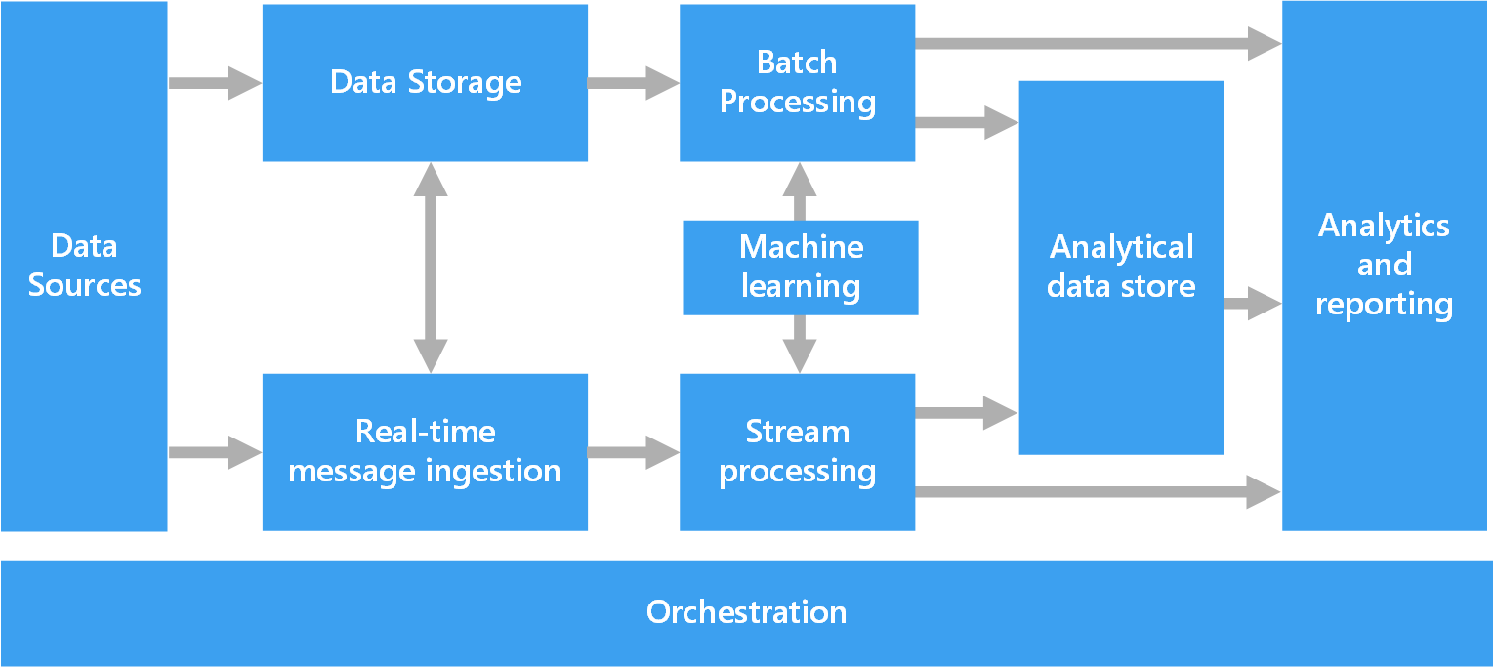
Azure Data Architecture Guide
Valuable collection of architecture principles to help you with your technology choices
https://aka.ms/adag

Slide 15
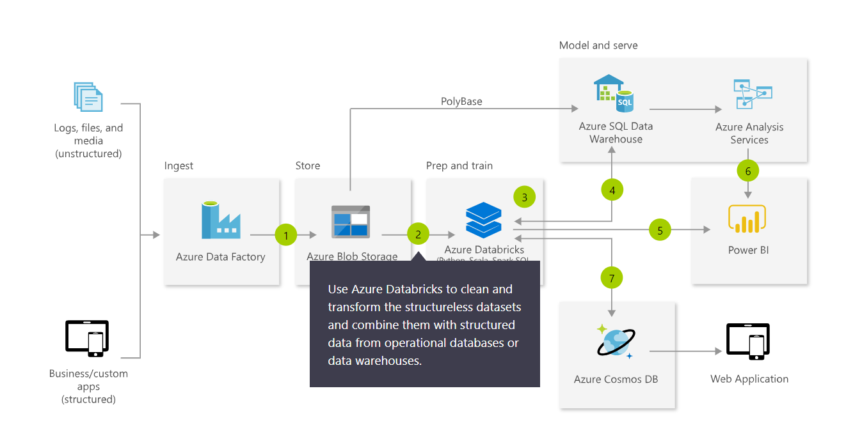
Azure Architecture Solutions
Collection of reference architectures for most common challenges
https://azure.microsoft.com/en-us/solutions/architecture/

Slide 16
Modern Data Platform Solution Scenarios
Big Data and advanced analytics
SQL
Modern data warehousing
Advanced analytics
Real-time analytics
“We want to integrate all our data—including Big Data—with our data warehouse”
“We’re trying to predict when our customers churn”
“We’re trying to get insights from our devices in real-time”

Slide 17
Modern Data Platform Concepts Part I

Slide 18
IaaS vs PaaS vs SaaS
On Premises
Physical / Virtual
Infrastructure
as a Service (IaaS)
Platform
as a Service (PaaS)
Software
as a Service (SaaS)
You manage
Applications
Applications
Applications
Applications
You scale, make resilient and manage
You scale, make
resilient & manage
Data
Data
Data
Data
Runtime
Runtime
Runtime
Runtime
Scale, Resilience and management by Microsoft
Middleware
Middleware
Middleware
Scale, Resilience and management by Microsoft
Middleware
O/S
O/S
O/S
O/S
Virtualization
Virtualization
Managed by Microsoft
Virtualization
Virtualization
Servers
Servers
Servers
Servers
Storage
Storage
Storage
Storage
Networking
Networking
Networking
Networking
Azure
Virtual Machines
Azure
Cloud Services

Slide 19
What is a Data Warehouse?
A data warehouse is a large collection of business data used to help an organization make decisions. Data in the Data Warehouse has been identified as valuable to specifically defined business cases and is stored in a structured way readily available for reporting and data analysis.
It is not a Database
Different workload types: transactional (DB) versus analytics (DW)
It is not a Data Lake
They are different, can co-exist and compliment each other
It is not a Data Mart
A data mart is a subject-oriented database populated from a subset of the Data Warehouse
Notes:
Characteristics

Slide 20
Modern Data Warehousing

Slide 21
Modern data warehousing
The modern data warehouse extends the scope of the data warehouse to serve Big Data that’s prepared with techniques beyond relational ETL
SQL
Modern data warehousing
Advanced analytics
Real-time analytics
“We want to integrate all our data—including Big Data—with our data warehouse”
“We’re trying to predict when our customers churn”
“We’re trying to get insights from our devices in real-time”

Slide 22
Modern data warehousing pattern
LOB
CRM
INGEST
STORE
PREP
MODEL & SERVE (& store)
BI + Reporting
Graph
Advanced Analytics
Image
Social
Data orchestration and monitoring
Big data store
Transform & Clean
Data warehouse
AI
IoT
Cloud
Notes:
Slide objectives:
- Explain that the pattern (ingest, store, prepare and model&serve) is consistent. It is going to be applied using different technologies depending on the data scenario.

Slide 23
SQL Server and Azure SQL Database

Slide 24


Modernize on premises with SQL Server 2019
Now with big data clusters
Intelligence over any data
Choice of platform and language
Industry-leading performance
Most secure over the last 8 years⁵
Insights in minutes and rich reports
SQL
+
Analytics over structured and unstructured data with the power of SQL and Apache Spark
T-SQL
Java
C/C++
SCALA
Node.js
C#/VB.NET
Python
Ruby
.NET core
#1 OLTP performance¹
#1 DW performance on 1TB², 10TB³, and 30TB⁴
The best of Power BI and SQL Server Reporting Services in Power BI Report Server
In-memory across all workloads
Most consistent data platform
Private cloud
1/10th the cost of Oracle
Public cloud
All TPC Claims as of 1/19/2018.
¹ http://www.tpc.org/4081; ² http://www.tpc.org/3331; ³ http://www.tpc.org/3326; ⁴ http://www.tpc.org/3321; ⁵ National Institute of Standards and Technology Comprehensive Vulnerability Database
Notes:
Bob to cover
That’s not all it can do. SQL Server 2017 continues to deliver industry-leading capabilities:
Our latest performance benchmarks on Windows and Linux blow away our old records.
OLTP – We have #1 OLTP TPC-E performance
DW: And, we have the fastest performing DW. With best price/performance.
We offer the most secure database.
According to US National Institute of Standards and Technology (NSIT), we have had fewer vulnerabilities over the last 7 years than Oracle or IBM
Fewer vulnerabilities mean less patching for you!
SQL Server is the first commercial database with Advanced Analytics using R and Python built-in.
Why does this matter to you?
Now you can use SQL Server to operationalize your data science models in a secure and performant way
Use native T-SQL commands to score data in near real-time
And unlike our competitors, mobile BI on every device comes built-in. Or add access to powerful, self-service BI visualizations through Power BI - at a fraction of the cost of our competitors.
SQL Server 2017 gives you your choice of platform and language, and the most consistent on-prem to cloud environment.
And it does all this for 1/10th the cost of Oracle

Slide 25
SQL Server 2019 big data, analytics, and AI
Data virtualization
Managed SQL Server, Spark, and data lake
Complete AI platform
Admin portal and management services
Integrated AD-based security
Analytics
T-SQL
Apps
REST API containers for models
SQL Server External Tables
SQL Server
Spark
SQL Server
ML Services
Spark & Spark ML
Compute pools and data pools
Scalable, shared storage (HDFS)
Open database connectivity
NoSQL
Relational databases
HDFS
External data sources
HDFS
Combine data from many sources without moving or replicating it
Scale out compute and caching to boost performance
Store high volume data in a data lake and access it easily using either SQL or Spark
Management services, admin portal, and integrated security make it all easy to manage
Easily feed integrated data from many sources to your model training
Ingest and prep data and then train, store, and operationalize your models all in one system
Notes:
Amit to cover

Slide 26
Azure SQL Database resource types
Azure SQL Database
Single
Elastic Pool
Managed Instance
Database-scoped deployment option with predictable workload performance
Shared resource model optimized for greater efficiency of multi-tenant applications
Instance-scoped deployment option with high compatibility with SQL Server and full PaaS benefits
Best for apps that require resource guarantee at database level
Best for SaaS apps with multiple databases that can share resources at database level, achieving better cost efficiency
Best for modernization at scale with low friction and effort
Notes:
Introducing Azure SQL Database Managed Instance
SQL Database Managed Instance is an expansion of the existing SQL Database service designed to enable database migration to a fully-managed database service, without re-designing the application.
It’s important to note that Managed Instance isn’t a new service – it is a third resource type within Azure SQL Database, sitting alongside single databases and elastic pools. As part of Azure SQL Database, Microsoft’s fully managed cloud database service, it inherits all its built-in features.
Each standalone database is assigned a certain amount of resources via performance tiers: Basic, Standard, and Premium. The emphasis of this offering focuses on a simplified database-scoped programming model and applications with a predictable pattern and relatively stable workload.
An elastic database pool is a shared resource model that enables higher resource utilization efficiency, and all the databases within an elastic pool share predefined resources within the same pool. The emphasis of this offering is on a simplified database-scoped programming model for multi-tenant SaaS apps. The workload pattern is well-defined and is highly cost-effective in multi-tenant scenarios. For ISVs with SaaS apps, the savings can be significant, in the hundreds of thousands of dollars or more.
A SQL Database Managed Instance offers a simplified instance-scoped programming model that is like an on-premises SQL Server instance. The databases in a SQL Database Managed Instance share the resources allocated to the Managed Instance, and the Managed Instance also represents the management grouping for these databases. The emphasis of this offering is on high compatibility with the programming model of an on-premises SQL Server and out-of-box support for a large majority of SQL Server features and accompanying tools/services.

Slide 27
Azure SQL Managed Instance
Enable full isolation from other tenants without resource sharing
Promote secure communication over private IP addresses with native VNET integration
Enable your on-premise identities on cloud instances, through integration with Azure Active Directory and AD Connect
Combine the best of SQL Server with the benefits of a fully-managed service
Use familiar SQL Server features in SQL Database Managed Instance
VNET support in SQL Database Managed Instance
VNet-to-VNet
Web app (public IP)
VNet2
SQL instance #1
SQL instance #2
Network isolation (customer VNET)
Tenant isolation (compute, storage)
SQL instance #3
VNet1
“Virtual data cluster” dedicated to customer (virtual private cluster, VNET, private IPs)
VPN/Express route gateway
On-premises
Notes:
SQL Database Managed Instance provides complete workload isolation of your workloads through native VNET support. We use virtual data clusters to describe the degree of isolation that customer workloads will experience with SQL Database Managed Instance. During service provisioning (on Azure Portal or through REST API), you can choose the virtual network (VNET) and the subnet to achieve full networking isolation for your Managed Instances. Once created, instances in the VNET can be reached using Azure networking mechanisms (VPN and Express Route gateways).
To two levels of isolation are provided:
Cluster (tenant ring) level: Managed Instances for a tenant are fully isolated from other tenants. No connectivity or resource sharing is possible between different tenants.
Networking level: joining instances to a subnet in a VNET and restricting access to private IP addresses only provides full isolation from public Internet.

Slide 28
Azure Data Factory

Slide 29




Azure Data Factory
Data Integration Service: Serverless, Scalable, Hybrid
Azure
Ent Apps & Data
SaaS
Clouds
Hybrid Pipeline Model
Seamlessly span: on prem, Azure, other clouds & SaaS
Run on-demand, scheduled, data-availability or on event
Data Movement @Scale
Cloud & Hybrid w/ 75+ connectors provided
Up to 1 GB/s
SSIS Package Execution
Lift existing SQL Server ETL to Azure
Use existing tools (SSMS, SSDT)
Author & Monitor
Programmability w/ multi-language SDK
Visual Tools

Slide 30
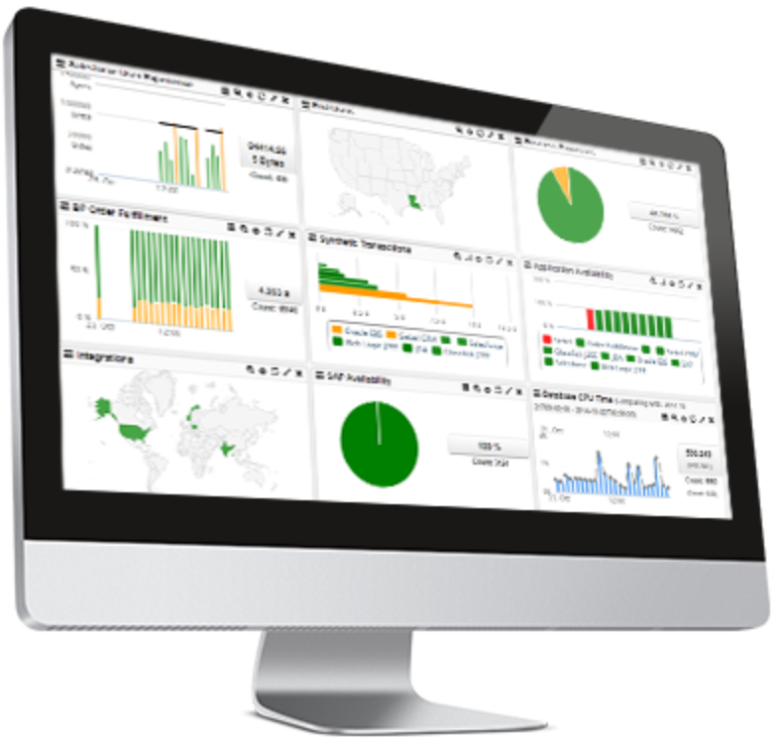












Command and Control
Data
Data Factory
A data integration account.
Location of orchestration, service metadata
UX & SDK
Authoring | Monitoring/Mgmt
Azure Data Factory v2 Service
Scheduling | Orchestration | Monitoring
Integration Runtime (IR)
ADF’s execution engine
Azure Integration Runtime
Self-Hosted Integration Runtime
SSIS Integration Runtime
Three core capabilities:
data movement
pipeline activity execution
SSIS package execution
Pipeline
SSIS Package
Self Hosted
Integration Runtime
Azure
Integration
Runtime
Azure Svcs
On Prem Apps & Data
Cloud & SaaS

Slide 31
Command and Control
Data
Trigger
Pipeline
foreach (…)
On demand
Schedule
Data Window
Event
Activity
Activity
Activity
Activity
Activity
Runs on
Self Hosted
Integration Runtime
Azure
Integration
Runtime
Linked Service
On Prem Apps & Data
Azure Services

Slide 32
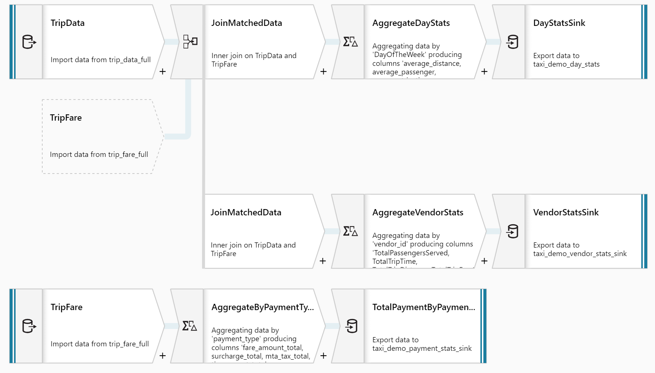
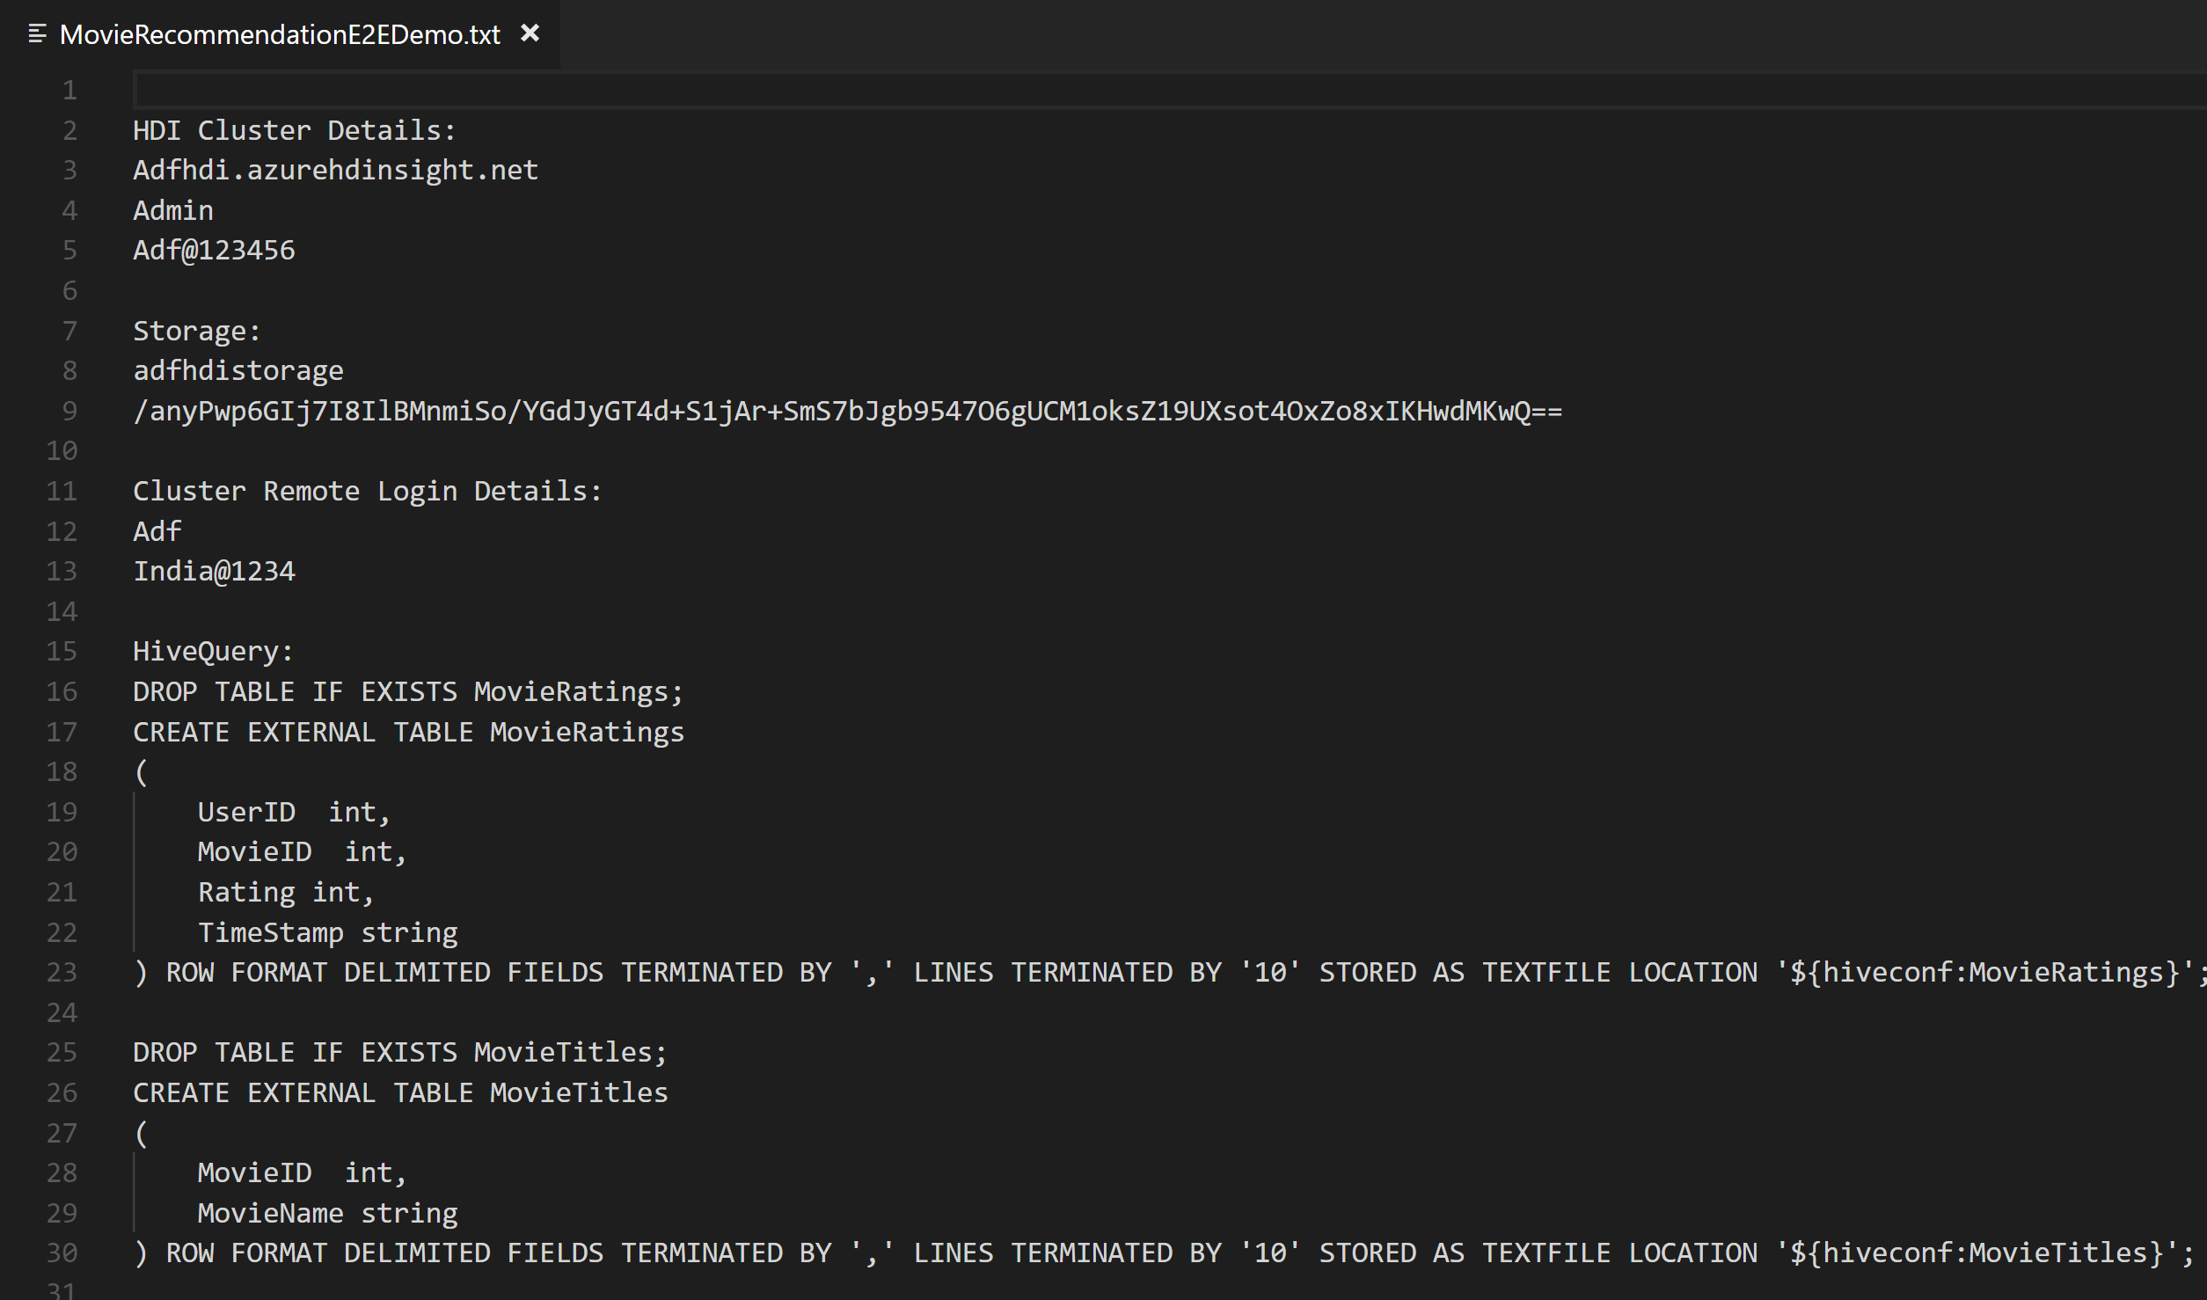
Mapping Data Flow
No-code data transformation @ scale
Data cleansing, transformation, aggregation, conversion, etc.
Cloud scale via Spark execution
Easily build resilient data flows
… not

Slide 33
Azure SQL Data Warehouse

Slide 34
Azure SQL Data Warehouse
Best in class
price-performance
Industry-leading security
Intelligent workload management
Data flexibility
Developer productivity
Up to 14X times faster and 94% less expensive than cloud competitors
Defense-in-depth security and 99.9% financially backed availability SLA
Separation of compute and storage
Prioritize resources for the most valuable workloads
Query directly over the Data Lake
Support for structured and semi-structured data
Enterprise class application lifecycle management

Slide 35
Azure SQL Data Warehouse MPP Architecture
Cores
Memory
Cores
Memory
Cores
Memory
NVMe SSD
NVMe SSD
NVMe SSD
Compute
Cache
TempDB
Cache
TempDB
Cache
TempDB
Data
Remote storage
Snapshot backups
Log

Slide 36
Table Distributions
Round-robin distributed
Distributes table rows evenly across all distributions at random.
Hash distributed
Distributes table rows across the Compute nodes by using a deterministic hash function to assign each row to one distribution.
Replicated
Full copy of table accessible on each Compute node.
CREATE TABLE [dbo].[FactInternetSales]
(
[ProductKey] int NOT NULL,
[OrderDateKey] int NOT NULL,
[CustomerKey] int NOT NULL,
[PromotionKey] int NOT NULL,
[SalesOrderNumber] nvarchar(20) NOT NULL,
[OrderQuantity] smallint NOT NULL,
[UnitPrice] money NOT NULL,
[SalesAmount] money NOT NULL
)
WITH
(
CLUSTERED COLUMNSTORE INDEX,
DISTRIBUTION = HASH([ProductKey]) |
ROUND ROBIN |
REPLICATED
);

Slide 37
Polybase
Data ingestion using external data sources
-- Create Azure DataLake Gen2 Storage reference
CREATE EXTERNAL DATA SOURCE AzureStorage with
(
TYPE = HADOOP, LOCATION='abfss://<container>@<storageaccnt>.blob.core.windows.net',
CREDENTIAL = AzureStorageCredential –- not required if using managed identity
);
-- Type of format in Hadoop (CSV, RCFILE , ORC, PARQUET).
CREATE EXTERNAL FILE FORMAT TextFileFormat WITH
(
FORMAT_TYPE = DELIMITEDTEXT,
FORMAT_OPTIONS (FIELD_TERMINATOR ='|', USE_TYPE_DEFAULT = TRUE)
)
-- LOCATION: path to file or directory that contains data
CREATE EXTERNAL TABLE [dbo].[CarSensor_Data]
(
[SensorKey] int NOT NULL,
[Speed] float NOT NULL,
[YearMeasured] int NOT NULL
)
WITH (LOCATION='/Demo/’, DATA_SOURCE = AzureStorage, FILE_FORMAT = TextFileFormat
);
Overview
Polybase supports querying files stored in a Hadoop File System (HDFS), Azure Blob storage, or Azure Data Lake Store.
To query files, users create three objects: External data source, external file format, external table.

Slide 38
Lab 1: Load data into Azure SQL Data Warehouse using Azure Data Factory Pipelines

Slide 39
Lab 1
Relational Data Sources

Slide 40
Lab 1
Lab Architecture

Slide 41
Modern Data Platform Concepts Part II

Slide 42
What is a Data Lake?
It is a central storage repository that holds data coming from many sources in a raw, granular format. It can store structured, semi-structured, or unstructured data, which means data ingested quickly and can be kept in a more flexible format for future use cases.
Characteristics
Schema-on-read (ELT)
Collection of data, not a platform
Benefits
Quickly ingest high volumes of diverse data structures
Enable advanced analytics and data exploration
Scalability and storage cost reduction
Best Practices
Data Governance needed to avoid Data Swamp
Security considerations
Perfect place for evolving data
Design your Data Lake
Metadata management
Notes:
Characteristics

Slide 43
Data Warehouse or Data Lake?
Answer: both.
 | Data Warehouse | Data Lake
Requirements | Relational requirements | Diverse data, scalability, low cost
Data Value | Data of recognised high value | Candidate data of potential value
Data Processing | Mostly refined calculated data | Mostly detailed source data
Business Entities | Known entities, tracked over time | Raw material for discovering entities and facts
Data Standards | Data conforms to enterprise standards | Fidelity to original format and condition
Data Integration | Data integration upfront | Data prep on demand
Transformation | Data transformed, in principle | Data repurposed later, as needs arise
Schema Definition | Schema-on-write | Schema-on-read
Metadata Management | Metadata improvement | Metadata developed on read

Slide 44
Data Lake Design Considerations
Data Lake Zones
Transient Landing Zone
Temporary storage of data to meet regulatory and quality control requirements. Limited access. May not be required depending on requirements.
Raw Zone
Original source of data ready for consumption. Metadata publicly available but access to data still limited.
Trusted Zone
Standardized and enriched datasets ready for consumption to those with appropriate role-based access. Metadata available to all.
Curated/Refined Zone
Data transformed from Trusted Zone to meet specific business requirements.
Sandbox Zone
Playground for Data Scientists for ad hoc exploratory use cases.
Data Governance Considerations
Security and Compliance
Access Control
Encryption
Row-Level Security
Metadata Management
Data Quality
Metadata Management
Lifecycle Management

Slide 45
Azure Data Lake Storage Gen2

Slide 46

Azure Data Lake Storage Gen2
High performance HDFS Endpoint to Azure Blob Storage
Blob API
Gen2 API
Unstructured Object Data
File Data
Server Backups, Archive Storage, Semi-structured Data
Hadoop File System, File and Folder Hierarchy, Granular ACLS Atomic File Transactions
Common Blob Storage Foundation
Object Tiering and Lifecycle Policy Management
AAD Integration, RBAC, Storage Account Security
HA/DR support through ZRS and RA-GRS
* Full Blob and HNS Interoperability available in post-GA

Slide 47



Azure Data Lake Storage Gen2
CDO, VP of analytics
Data Engineer
Data Scientists
Low Cost Storage for structured and unstructured data
Meets data sovereignty requirements in multiple geographies
Granular file and folder level security
Supports Azure Active Directory Integration and other advanced security features available in Blob Storage
Inherits object level tiering and advanced HA/DR capabilities of Blob Storage
Supports familiar REST API and HDFS file system
Integration with leading Hadoop and Spark analytic engines like Databricks
Low Cost Storage for structured and unstructured data
Strong analytics ISV support
Granular file and folder level security
Supports Azure Active Directory Integration and other advanced security features available in Blob Storage
Fast performance leads to lower end to end analytic job run times
Integration with leading Hadoop and Spark analytic engines like Databricks
Supports integration with visualization tools like Power BI and Tableau
Granular file and folder level security

Slide 48
Azure Storage Replication
Highly available and resilient data storage
Typically >300mi
Typically >300mi
Zone 1
Zone 2
Zone 3
Async
Async
Primary
Secondary
Primary
Secondary
LRS
Multiple replicas across a datacenter
Protect against disk, node, rack failures
Write is ack’d when all replicas are committed
Superior to dual-parity RAID
11 9s of durability
SLA: 99.9%
ZRS
Replicas across 3 Zones
Protect against disk, node, rack and zone failures
Synchronous writes to all 3 zones
12 9s of durability
Available in 8 regions
SLA: 99.9%
GRS
Multiple replicas across each of 2 regions
Protects against major regional disasters
Asynchronous to secondary
16 9s of durability
SLA: 99.9%
RA-GRS
GRS + Read access to secondary
Separate secondary endpoint
RPO delay to secondary can be queried
SLA: 99.99% (read), 99.9% (write)

Slide 49
Lab 2: Transform Big Data using Azure Data Factory and Azure SQL Data Warehouse

Slide 50
Lab 2
Semi-Structured Data Sources

Slide 51
Lab 2
Lab Architecture

Slide 52
Advanced Analytics

Slide 53
Advanced analytics
Advanced analytics goes beyond the traditional business intelligence (BI) and uses mathematical, probabilistic, and statistical modeling techniques to enable predictive processing and automated decision making.
SQL
Modern data warehousing
Advanced analytics
Real-time analytics
“We want to integrate all our data—including Big Data—with our data warehouse”
“We’re trying to predict when our customers churn”
“We’re trying to get insights from our devices in real-time”

Slide 54
Modern Data Platform Concepts Part III

Slide 55


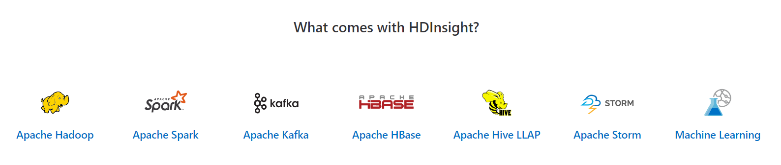
Hadoop and Spark in Azure
Open Source Apache Projects for Big Data Compute
It was the original open-source framework for distributed processing and analysis of big data sets on clusters.
Read/write from disk.
Economical batch mode.
Linear processing of huge datasets.
Effective, fast, general-purpose unified cluster computing framework with high-level APIs in Java, Scala, Python and R.
In-memory processing.
Fast, interactive data processing.
Streaming and Machine Learning Support
Azure HDInsight is a managed, full-spectrum, open-source analytics service for enterprises

Slide 56
Apache Spark Value Proposition
Performance
Run programs up to 100x faster than Hadoop MapReduce in memory
10x faster on disk
Useful for real-time and batch processing
Productivity
Write applications quickly in Scala or Python, Java
Over 80 high-level operators that make it easy to build parallel apps
Use interactively from the Scala and Python shells
Unified and integrated analytics model
Includes higher-level libraries in integrated framework
Combine SQL, streaming, graph processing
Runs on Hadoop (Yarn, Mesos), standalone, or in the cloud
Diverse data sources including HDFS (CSV, JSON, etc.), Azure Storage, Cosmos DB, Azure SQL Data Warehouse, Parquet, JDBC
Open
Apache Project
Contributors: 50 companies and over 400 developers, growing

Slide 57
Azure Databricks

Slide 58



Azure Databricks
A fast, easy and collaborative Apache® Spark™ based analytics platform optimized for Azure
Best of Databricks
Best of Microsoft
Designed in collaboration with the founders of Apache Spark
One-click set up; streamlined workflows
Interactive workspace that enables collaboration between data scientists, data engineers, and business analysts.
Native integration with Azure services (Power BI, SQL DW, Cosmos DB, ADLS, Azure Storage, Azure Data Factory, Azure AD, Event Hub, IoT Hub, HDInsight Kafka, SQL DB)
Enterprise-grade Azure security (Active Directory integration, compliance, enterprise-grade SLAs)

Slide 59
Azure Databricks
Azure Databricks
Collaborative Workspace
IoT / streaming data
Machine learning models
DATA ENGINEER
DATA SCIENTIST
BUSINESS ANALYST
Deploy Production Jobs & Workflows
Cloud storage
BI tools
MULTI-STAGE PIPELINES
JOB SCHEDULER
NOTIFICATION & LOGS
Data warehouses
Optimized Databricks Runtime Engine
Data exports
Hadoop storage
DATABRICKS I/O
APACHE SPARK
SERVERLESS
Rest APIs
Data warehouses
Enhance Productivity
Build on secure & trusted cloud
Scale without limits

Slide 60



















Azure Databricks Deployment
Managed Resource Group
Cluster Node(s)
Attached Azure BLOB (DBFS)
Workspace
VNET
Workspace
NSG rules
Azure Portal
Integrate with other Azure Services
Azure BLOBs
Data Lake
Azure Databricks Workspace
Notebooks
Run on
Clusters
Event Hub
IOT Hub
Kafka
Cosmos DB
SQL DW
Jobs
Azure Resource Manager APIs
Interact using UI or Azure Databricks REST API
Data Factory

Slide 61
Azure Databricks Clusters
Driver Program SparkContext
Azure Databricks clusters are the set of Azure Linux VMs that host the Spark Worker and Driver Nodes
Your Spark application code (i.e. Jobs) runs on the provisioned clusters.
Azure Databricks clusters are launched in your subscription—but are managed through the Azure Databricks portal.
Azure Databricks provides a comprehensive set of graphical wizards to manage the complete lifecycle of clusters—from creation to termination.
Cluster Manager
Worker Node
Worker Node
Worker Node
Cache
Cache
Cache
Task
Task
Task
Data Sources (HDFS, SQL, NoSQL, …)

Slide 62
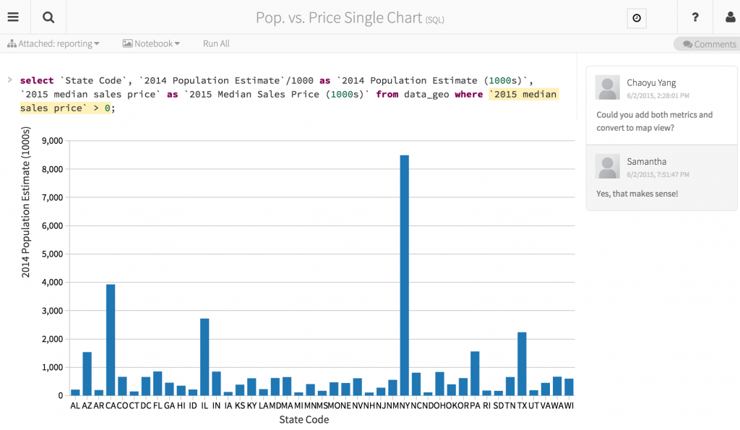
Azure Databricks Notebooks
Notebooks are a popular way to develop, and run, Spark Applications
Notebooks are not only for authoring Spark applications but can be run/executed directly on clusters
Shift+Enter
click the at the top right of the cell in a notebook
Submit via Job
Fine grained permissions support so they can be securely shared with colleagues for collaboration
Notebooks are well-suited for prototyping, rapid development, exploration, discovery and iterative development
With Azure Databricks notebooks you have a default language but you can mix multiple languages in the same notebook:
%python Allows you to execute python code in a notebook (even if that notebook is not python)
%sql Allows you to execute sql code in a notebook (even if that notebook is not sql).
%r Allows you to execute r code in a notebook (even if that notebook is not r).
%scala Allows you to execute scala code in a notebook (even if that notebook is not scala).
%sh Allows you to execute shell code in your notebook.
%fs Allows you to use Databricks Utilities - dbutils filesystem commands.
%md To include rendered markdown

Slide 63
Lab 3: Explore Big Data with Azure Databricks

Slide 64
Lab 3
Semi-Structured Data Sources

Slide 65
Lab 3
Lab Architecture

Slide 66
Modern Data Platform Concepts Part IV

Slide 67
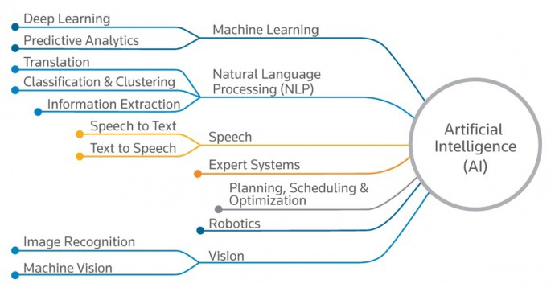
Artificial Intelligence
“The ability of a digital computer or computer-controlled robot to perform tasks commonly associated with intelligent beings.” – Encyclopedia Britannica
Machine Learning
Supervised Learning
Regression
Classification
Unsupervised Learning
Cluster Analysis
Application Examples
Weather Forecast
Fraud Detection
Customer Churn
Insurance Premium

Slide 68
What’s No-SQL?
Term coined in 2009 for a developer meetup – ”Not Only SQL” -> “NoSQL”.
Databases that allow you to store and retrieve data in various structures, formats, and models other than tabular relational model.
There’s a time and a place for everything
Sometimes a relational store is the right choice
Sometimes a NoSQL store is the right choice
Sometimes you need more than one store for an app -> polyglot persistence
Data Structures
Key-Value Databases
Redis Cache, Azure Table
Column Family Stores
Cosmos DB, Cassandra, HBase
Graph Databases
Cosmos DB, Neo4j, Gremlin
Document Databases
Cosmos DB, MongoDB

Slide 69
Microsoft AI

Slide 70
The Microsoft AI platform: Azure & AI
Option 1: High level intro
Services
Tools
Infrastructure
Notes:
It’s all about three pieces: our Azure services, our infrastructure, and our tools.

Slide 71
Option 2: Detailed intro
Microsoft AI Platform
Azure AI Services
PRE-BUILT AI
CONVERSATIONAL AI
CUSTOM AI
CODING & MANAGEMENT TOOLS
Cognitive Services
Tools
Bot Service
Azure Machine Learning
VS Tools for AI
Azure ML Studio
Azure ML Workbench
Others (PyCharm, Jupyter Notebooks…)
Azure Infrastructure
DEEP LEARNING FRAMEWORKS
AI ON DATA
AI COMPUTE
3rd Party
Cosmos DB
SQL
DB
SQL
DW
Data Lake
Spark
DSVM
Batch AI
ACS
IoT Edge
Cognitive Toolkit
TensorFlow
Caffe
CPU, FPGA, GPU
Others (Scikit-learn, MXNet, Keras, Chainer, Gluon…)
Notes:
Let’s start with AI services. We provide the most comprehensive set of AI services for any developer, any organization, and any scenario.
We have pre-built AI services with Cognitive Services. We were the first ones in the market to release this concept of AI as a service, and we are leaders in terms of developer adoption, number of services and capabilities provided. We have the unique capability for developers to customize these services for any particular scenario, something our competitors are only in the very early stages of.
We also have the most powerful bot platform, fully integrated with these services, enabling organizations to embrace conversational AI and connect them with their business processes.
And finally, we also provide a full solution for custom AI with Azure Machine Learning, covering the entire lifecycle of AI development in the Enterprise, from training to deployment.
All of this is based on the powerful infrastructure provided by Azure. We are taking all that power and applying it to AI, from CPU compute to GPU and next, FPGA.
We have a huge lever in the market with our tools. We’re taking the power of Visual Studio and Visual Studio Code to AI development. We are unique in our ability to provide a full solution across services and tools to make AI development productive and approachable.
Every developer can be an AI developer with this unique combination.
Lastly, we take an open approach to this solution. These tools and services work across any framework, we don’t make the decision for you, so you are not locked in to a vendor.

Slide 72







Microsoft Cognitive Services
Give your apps a human side
Vision
From faces to feelings, allow your apps to understand images and video
Speech
Hear and speak to your users by filtering noise, identifying speakers, and understanding intent
Language
Process text and learn how to recognize what users want
Knowledge
Tap into rich knowledge amassed from the web, academia, or your own data
Search
Access billions of web pages, images, videos, and news with the power of Bing APIs
Labs
An early look at emerging Cognitive Services technologies: discover, try and give feedback on new technologies before general availability

Slide 73
Microsoft Cognitive Services
Give your apps a human side
Computer Vision
Content Moderator
Emotion
Face
Video Indexer
Custom Vision Service
Bing Speech
Speaker Recognition
Custom Speech Service
Bing Spell Check
Linguistic Analysis
Text Analytics
Translator Text & Speech
Web Language Model
Language Understanding
Academic Knowledge
Entity Linking
Knowledge Exploration
Recommendations
QnA Maker
Custom Decision Service
Bing Autosuggest
Bing Image Search
Bing News Search
Bing Video Search
Bing Web Search
Bing Entity Search
Bing Custom Search
Project Prague (gesture)
Project Cuzco (events)
Project Johannesburg (routing)
Project Nanjing (isochrones)
Project Abu Dhabi (distance matrix)
Project Wollongong (location)
Vision
Speech
Language
Knowledge
Search
Labs

Slide 74
Microsoft Cognitive Services
Give your apps a human side
Vision
Speech
Language
Knowledge
Search
Labs
Computer Vision
Content Moderator
Emotion
Face
Video Indexer
Bing Speech
Speaker Recognition
Bing Spell Check
Linguistic Analysis
Text Analytics
Translator Text & Speech
Web Language Model
Academic Knowledge
Entity Linking
Knowledge Exploration
Recommendations
QnA Maker
Bing Autosuggest
Bing Image Search
Bing News Search
Bing Video Search
Bing Web Search
Bing Entity Search
Project Prague (gesture)
Project Cuzco (events)
Project Johannesburg (routing)
Project Nanjing (isochrones)
Project Abu Dhabi (distance matrix)
Project Wollongong (location)
CUSTOMIZATION
Custom Vision Service
Custom Speech Service
Language Understanding
Custom Decision Service
Bing Custom Search

Slide 75
Microsoft Cognitive Services
Customization
The broadest set of custom AI services available, allowing customers to use their own data with algorithms that are customized for their specific needs.
Vision
Speech
Language
Knowledge
Search
Labs
Customizable web service that learns to recognize specific content in imagery
Fine-tune speech recognition for anyone, anywhere
Teach your apps to understand commands from your users
Create custom experiences with adaptive, contextual decision-making
Create a highly-customized web search experience
Custom Vision Service
Custom Speech Service
Language Understanding
Custom Decision Service
Bing Custom Search

Slide 76
Vision
Computer Vision API
Face API
Emotion API
Distill actionable information from images
Detect, identify, analyze, organize, and tag faces in photos
Personalize experiences with emotion recognition
Content Moderator
Custom Vision Service
Video Indexer
Machine-assisted moderation of text and images, augmented with human review tools
Customizable web service that learns to recognize specific content in imagery
Process and extract smart insights from videos
Notes:
Vision
Computer Vision API: Extract rich information from images to categorize and process visual data – and machine-assisted moderation of images to help curate your services.
Face API: Some potential uses for this technology include facial login, photo tagging, and home monitoring. Or attribute detection to know age, gender, facial hair, etc.
Emotion API: Build an app that responds to moods. Using facial expressions, this cloud-based API can detect happiness, neutrality, sadness, contempt, anger, disgust, fear, and surprise. The AI understands these emotions based on universal facial expressions, and it functions cross-culturally, so your app will work around the world. Some use cases would be an advertising company wants to test user response to an ad, a tv studio wants to track responses to a pilot.
Content Moderator: Image moderation - Enhance your ability to detect potentially offensive or unwanted images through machine-learning based classifiers, custom blacklists, and optical character recognition (OCR).
Text moderation - Helps you detect potential profanity in more than 100 languages and match text against your custom lists automatically. Content Moderator also checks for possible personally identifiable information (PII).
Video moderation - Enable the scoring of possible adult content in videos. Video moderation is currently deployed in preview on Azure Media Services.
Human review tool - Humans can effectively augment machine learning models in situations where the prediction confidence warrants assistance or when decisions must be tempered with a real world context. Enjoy visibility, flexibility and control with a human review tool that supervises the results of your algorithms.
Custom Vision Service: an easy-to-use, customizable web service that learns to recognize specific content in imagery, powered by state-of-the-art machine learning neural networks that become smarter with training. You can train it to recognize whatever you choose, whether that be animals, objects, or abstract symbols. This technology could easily apply to retail environments for machine-assisted product identification, or in digital space to automatically help sorting categories of pictures.
Video Indexer : It helps you unlock insights from any video by indexing and enabling you to search spoken audio that is transcribed and translated, sentiment, faces that appeared and objects. With these insights, you can improve discoverability of videos in your applications or increase user engagement by embedding this capability in sites. All of these capabilities are available through a simple set of APIs, ready to use widgets and a management portal.

Slide 77
Language
Bing Spell Check API
Web Language Model API
Linguistic Analysis API
Detect and correct spelling mistakes within your app
Leverage the power of language models trained on web-scale data
Easily parse complex text with language analysis
Language Understanding Intelligent Service
Text Analytics API
Translator
Teach your apps to understand commands from your users
Detect sentiment, key phrases, topics, and language from your text
Easily perform speech and text translation
Notes:
Bing Spell Check API: Microsoft’s state-of-the-art cloud-based spelling algorithms to detect a wide variety of spelling errors and provide accurate suggestions. Using Bing Spell Check, your mobile and PC apps will be powered with state-of-the-art spelling capabilities. Our service is trained on a massive corpus of data gleaned from billions of web pages. There is no need to train your own models. The speller model is updated regularly and incorporates new terms and brands almost as quickly as they appear on the web. This API is available through Microsoft Cognitive Services for customers with low-volume and high-latency jobs. For high-volume and low-latency we have an internal API which may be more suitable. Contact donaldbr directly for more information.
Use cases: 1) Improve the quality of a website's product search 2) provide spell correction for a keyboard app 3) provide spell correction for text fields in an app or web page 4) detect errors in UI text and user data. See https://blogs.msdn.microsoft.com/msr_er/2010/12/15/building-a-better-speller-bing-and-microsoft-research-offer-prizes-for-best-search-engine-spelling-alteration-services/ The speller is exceptional at common spelling errors with low edit-distance (such as febuary->February) but a lot of other spellers are good at that as well. We Do a very good job with word breaking, proper names in context (try "director stephen spielberg") and fictional character names, just a few examples. Areas that are a challenge are capitalization (we don't know what to do with "March" for example, even with context) and consistency (there are times when we will flag a word only intermittently based on the context).
Web Language Model API: Web Language API indexes the web and Bing queries to allow users to calculate the probabilities of natural language expressions and estimate a list of most likely words to follow an existing sequence of words. Use this API to insert spaces into a string of words without spaces, like a hashtag or URL. Use this API to rerank machine translation/speech recognition candidate sentences based on probability of the sentence.
Use this API for academic research. http://research.microsoft.com/apps/pubs/default.aspx?id=130762
We also have SDKs available for WebLM
Linguistic Analysis API: The Linguistic Analysis API helps you gain insights from text. Given a natural language parse, it’s easy to identify the concepts and entities (noun phrases), actions (verbs and verb phrases), descriptive words, and more. The processed text can provide useful features for classification tasks such as sentiment analysis.
We also have SDKs available for Linguistic Analysis.
Language Understanding Intelligent Service (LUIS) allows developers to build a model that understands natural language and commands tailored to their application. Example: You can say “turn down the thermostat in the living room,” send it to a LUIS model, and instead of just returning the text that represents what was said, LUIS will return: the action is “turn down,” the location is “living room,” and the target is “thermostat.” LUIS allows developers to iteratively build on these models and take speech or text input and return a structured representation of what the person said. Not only that but by build LUIS will help developers create and train smart conversational bot (Intercom or Slack) with a single button. LUIS will also offer action fulfillment capabilities by simple integration with webhooks. LUIS works pretty well it comes to intents. For the entities, the learning curve is slower especially when the number of entities increases. LUIS only supports 20 intents & 10 entities yet by build each entities can have up to 10 children.
Translator API: Translate speech and text
Language Detection Automatically detect the language of any text string.
Translation Add speech translation, for any of the 9 supported languages, and text translation, for any of the 60 supported languages, to your app.
Text to speech (TTS) Send text strings and receive back the audio version in one of the 19 supported languages.
Custom translation system Build a custom translation system, using as little as 1,000 parallel sentences or start out simply by providing a dictionary of company specific words.
Collaborative translation network Improve translations by creating a specific user group that provides suggestions to improve the translations.
Text Analytics API: At the time of publication, this data was not available. Please email Rebecca Duffy, reduffy@microsoft.com, if you would like more information.

Slide 78
Cosmos DB

Slide 79



Azure Cosmos DB
A globally distributed, massively scalable, multi-model database service
SQL
MongoDB
Table API
Column-family
Document
Key-value
Graph
Guaranteed low latency at the 99th percentile
Elastic scale out
of storage & throughput
Five well-defined consistency models
Turnkey global distribution
Comprehensive SLAs

Slide 80
Resource Model
Leveraging Azure Cosmos DB to automatically scale your data across the globe
Account
Database
Database
Database
Database
Database
Container
Database
Database
Item
Notes:
A tenant of the Cosmos DB service starts by provisioning a database account. A database account manages one or more databases. A Cosmos DB database manages users, permissions and containers. A Cosmos DB resource container is a schema-agnostic container of arbitrary user-generated JSON items and JavaScript based stored procedures, triggers and user-defined-functions (UDFs). Entities under the tenant’s database account – databases, users, permissions, containers etc. are referred to as resources.
Each resource is uniquely identified by a stable and logical URI and represented as a JSON document. The overall resource model of an application using Cosmos DB is a hierarchical overlay of the resources rooted under the database account, and can be navigated using hyperlinks. Except for the item resource, which is used to represent arbitrary user defined JSON content, all other resources have a system-defined schema.
Container and item resources are further projected as reified resource types for a specific type of API interface. For example, while using document-oriented APIs, container and item resources are projected as collection (container) and document (item) resources, respectively; likewise, for graph-oriented API access, the underlying container and item resources are projected as graph (container), node (item) and edge (item) resources respectively; while accessing using a key-value API table (container) and item/row (item) are projected.

Slide 81
Container Representations
Account
Database
Database
Database
Database
=
Database
Container
Collection
Graph
Table
Database
Database
Item

Slide 82
Container-Level Resources
Account
Database
Database
Database
Database
Database
Container
Database
Database
Sproc
Trigger
UDF
Conflict
Item

Slide 83
Lab 4: Add AI to your Big Data Pipeline with Cognitive Services

Slide 84
Lab 4
Non-Structured Data Sources

Slide 85
Lab 4
Lab Architecture

Slide 86
Real-time Analytics

Slide 87
Real-time analytics
Deals with streams of data that are captured in real-time and processed with minimal latency to generate real-time (or near-real-time) reports or automated responses.
SQL
Modern data warehousing
Advanced analytics
Real-time analytics
“We want to integrate all our data—including Big Data—with our data warehouse”
“We’re trying to predict when our customers churn”
“We’re trying to get insights from our devices in real-time”

Slide 88
Modern Data Platform Concepts Part V

Slide 89







Streaming Use Cases
Retail
Financial
Oil/Gas & Energy
Security
CONSUMER ENGAGEMENT
RISK AND REVENUE MANAGEMENT
GRID OPS, ASSET OPTIMIZATION
ACTIONABLE THREAT INTELLIGENCE
Real-time Pricing Optimization
Risk and Fraud, Threat Detection
Industrial IoT
Security Intelligence
Demand-Elasticity
Personal Pricing Schemes
Promotion events
Multi-channel engagement
Real-time anomaly detection
Card Monitoring and Fraud Detection
Risk Aggregation
Preventive Maintenance
Smart Grids and Microgrids
Asset performance as a Service
UAV image analysis
Real-time firewall, network, and auth log correlation
Anomaly detection
Security context, enrichment
Security Orchestration
Healthcare
Advertising
Media Entertainment
SENSOR DATA
RECOMMENDATION ENGINE
CONSUMER ENGAGEMENT ANALYSIS
And Much More!
IoT DEVICE
ANALYTICS
Next Best and Personalized Offers
Sentiment Analysis
Aggregation of streaming events
Predictive Maintenance
Anomaly Detection
Right product, promotion, at right time
Real time Ad bidding platform
Personalized Ad Targeting
Demand-Elasticity
Social Network Analysis
Promotion events
Multi-channel Attribution

Slide 90

Unlocking Real-time Insights
Time to Insight is Critical
Reducing decision latency can unlock business value
Insights are Perishable
Window of opportunity for insights to be actionable
Ask Questions to Data in Motion
Can’t wait for data to get to rest before running computation

Slide 91

Real-time Stream Processing
Simple Event Processing
Filter
Transform
Enrich
Split
Route
Event Stream Processing
[Simple event processing] +
Aggregate
Rules
Complex Event Processing
[Event Stream Processing] +
Pattern detection
Time windows
Joins & correlations

Slide 92

Scenario Types
Actions by Human Actors
“See and seize” insights
Live visualization
Alerts and alarms
Dynamic aggregation
Machine to Machine Interactions
Data movement with enrichment
Kick-off workflows for automation
Dashboarding
Automation
Enriched Data Movement

Slide 93
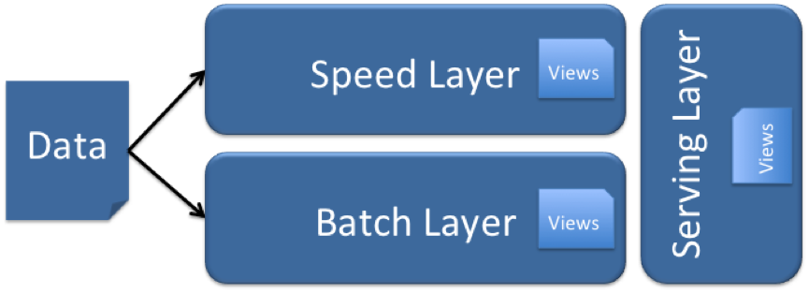
Lambda (λ) Architecture
Designed to handle Big Data use cases by taking advantage of both batch and stream-processing methods
All data entering the system is dispatched to both the batch layer and the speed layer for processing.
The batch layer has two functions:
manage the master dataset (an immutable, append-only set of raw data)
pre-compute the batch views.
The serving layer indexes the batch views so that they can be queried in low-latency, ad-hoc way.
The speed layer compensates for the high latency of updates to the serving layer and deals with recent data only.
Any incoming query can be answered by merging results from batch views and real-time

Slide 94
Event Hubs

Slide 95

Event Hubs
Big data streaming platform and event ingestion service capable of receiving and processing millions of events per second.

Slide 96
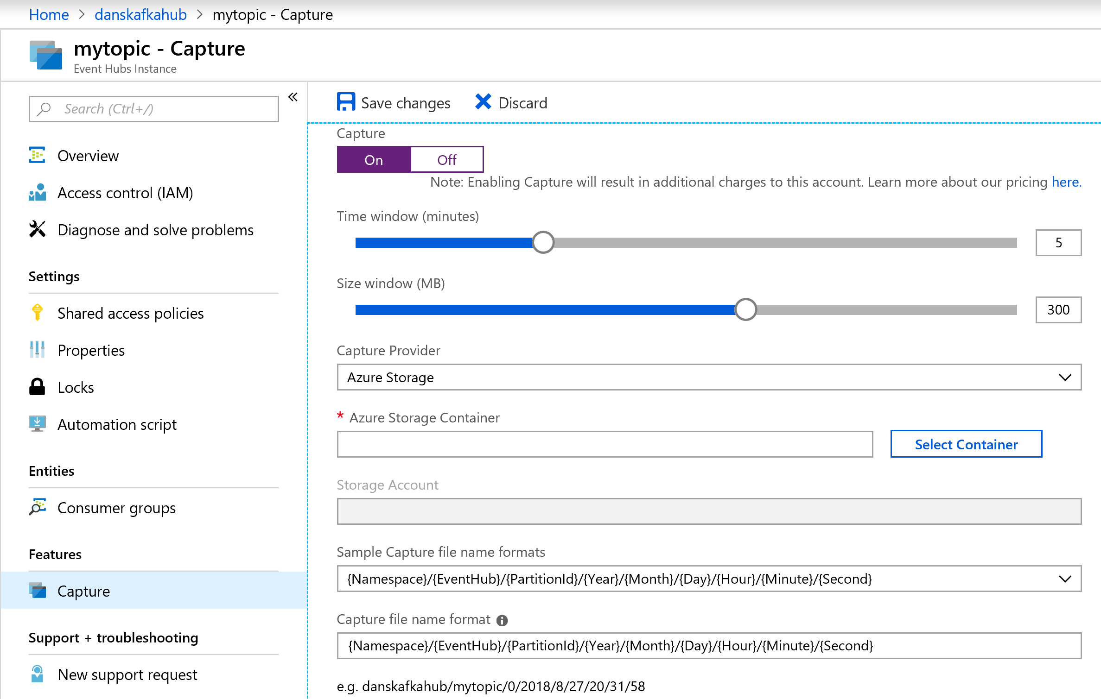
Event Hubs Capture
Batch on stream
Policy based push to your own storage
Uses Avro format
Raises Event Grid events – connect to Functions, ACI, or whatever you like
Does not impact throughput
Offloads batch processing from your real-time stream

Slide 97
Stream Analytics

Slide 98
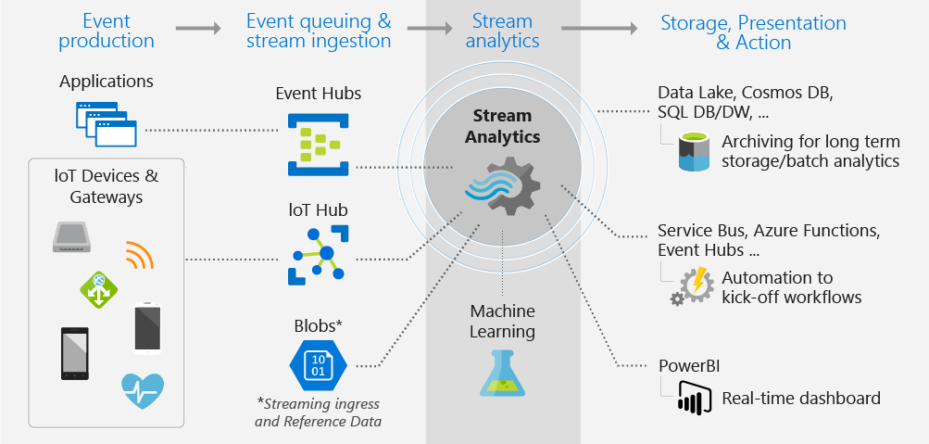
Stream Analytics
Event-processing engine that allows you to examine high volumes of data streaming from devices

Slide 99
Differentiators
1,915 lines of code with Apache Storm
Programmer Productivity
Declarative SQL like language
Built-in temporal semantics
Ease of Getting Started
Integrations with sources, sinks, & ML
Build real-time dashboards in minutes
Lowest Total Cost of Ownership(TCO)
Fully managed service
No cluster topology management required
Seamless scalability
Usage based pricing
@ApplicationAnnotation(name="WordCountDemo")
public class Application implements StreamingApplication
{
protected String fileName = "com/datatorrent/demos/wordcount/samplefile.txt";
private Locality locality = null;
@Override public void populateDAG(DAG dag, Configuration conf)
{
locality = Locality.CONTAINER_LOCAL;
WordCountInputOperator input = dag.addOperator("wordinput", new WordCountInputOperator());
input.setFileName(fileName);
UniqueCounter<String> wordCount = dag.addOperator("count", new UniqueCounter<String>());
dag.addStream("wordinput-count", input.outputPort, wordCount.data).setLocality(locality);
ConsoleOutputOperator consoleOperator = dag.addOperator("console", new ConsoleOutputOperator());
dag.addStream("count-console",wordCount.count, consoleOperator.input);
}
}
3 lines of SQL in Azure Stream Analytics
SELECT Avg(Purchase), ScoreTollId, Count(*)
FROM GameDataStream
GROUP BY TumblingWindows(5, Minute), Score

Slide 100
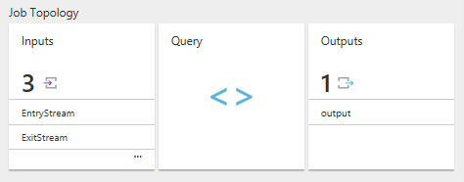
Stream Analytics Job
Users construct and deploy jobs to Azure Stream Analytics
Job definition includes inputs, a query, and output
Inputs are from where the job reads the data stream
Query runs for perpetuity unless explicitly stopped and transforms the input stream
Output is where the job sends the job results to

Slide 101
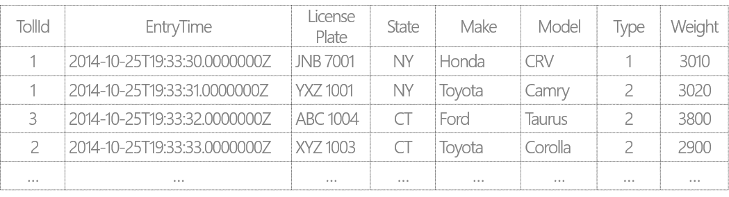
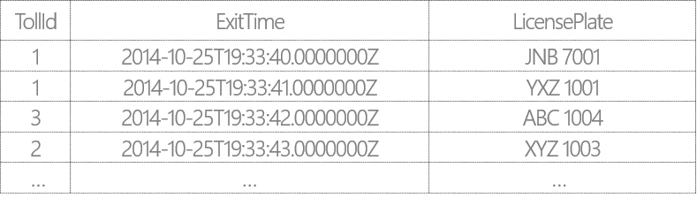
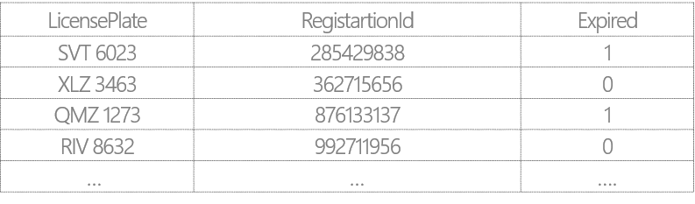
Example Scenario: Tolling Stations
Tolling stations have multiple booths (identified by TollId)
Each booth has two sensors: Entry and Exit that send out EntryStream and ExitStream respectively
EntryStream – Data stream from the Entry sensor data on vehicles entering toll booths
ExitStream - Data stream from the Exit sensor on vehicles exiting toll booths
ReferenceData - Commercial vehicle registration data

Slide 102
Filters and Projections
SELECT VehicleCategory =
Case Type
WHEN 1 THEN ‘Passenger’
WHEN 2 THEN ‘Commercial’
ELSE THEN ‘Other’
END,
TollId,
LicensePlate,
State,
Make,
Model,
DATEPART(mi,EntryTime) AS ‘Mins’,
DATEPART(ss,EntryTime) AS ‘Seconds’
DATEPART(ms,EntryTime) AS ‘Milleseconds’
FROM EntryStream TIMESTAMP BY EntryTime
WHERE (State = ‘CA’ OR State = ‘WA’)
AND Weight < 3000
AND CHARINDEX (‘M’, model) = 0
AND PATINDEX(‘%999’, LicensePlate) = 5
From the incoming stream find only vehicles that:
Are from either WA and CA state
Have a weight less than 3000 lbs
Have License plate number end in 999
Have a make that starts with a “M”
Display:
“Passenger” if type = 1
“Commercial” if Type = 2
“Other” for all other types
Display time as ‘Mins’, ‘Seconds’, ‘Milliseconds’

Slide 103
Temporal Joins
Report the time in seconds required for vehicles to pass the toll booth
SELECT ES.TollId,
ES.EntryTime,
EX.ExitTime,
ES.EntryTime,
ES.LicensePlate DATEDIFF(minute, ES.EntryTime, EX.ExitTime )
FROM EntryStream ES TIMESTAMP BY EntryTime
JOIN ExitStream EX TIMESTAMP BY ExitTime
ON (EX.TollId= ES.TollId and ES.LicensePlate = EX.LicensePlate)
AND DATEDIFF(minute, ES, EX) BETWEEN 0 AND 15

Slide 104
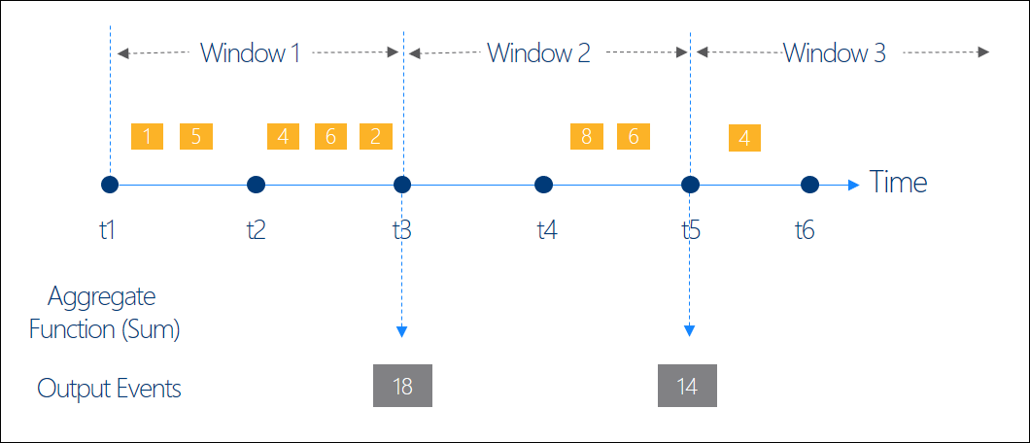
Windowing Concepts
Operations on the data contained in temporal windows is a common pattern
Four types of Temporal Windows:
Sliding
Tumbling
Hopping
Session
Output at the end of each window
Windows are fixed length
Used in a GROUP BY clause

Slide 105
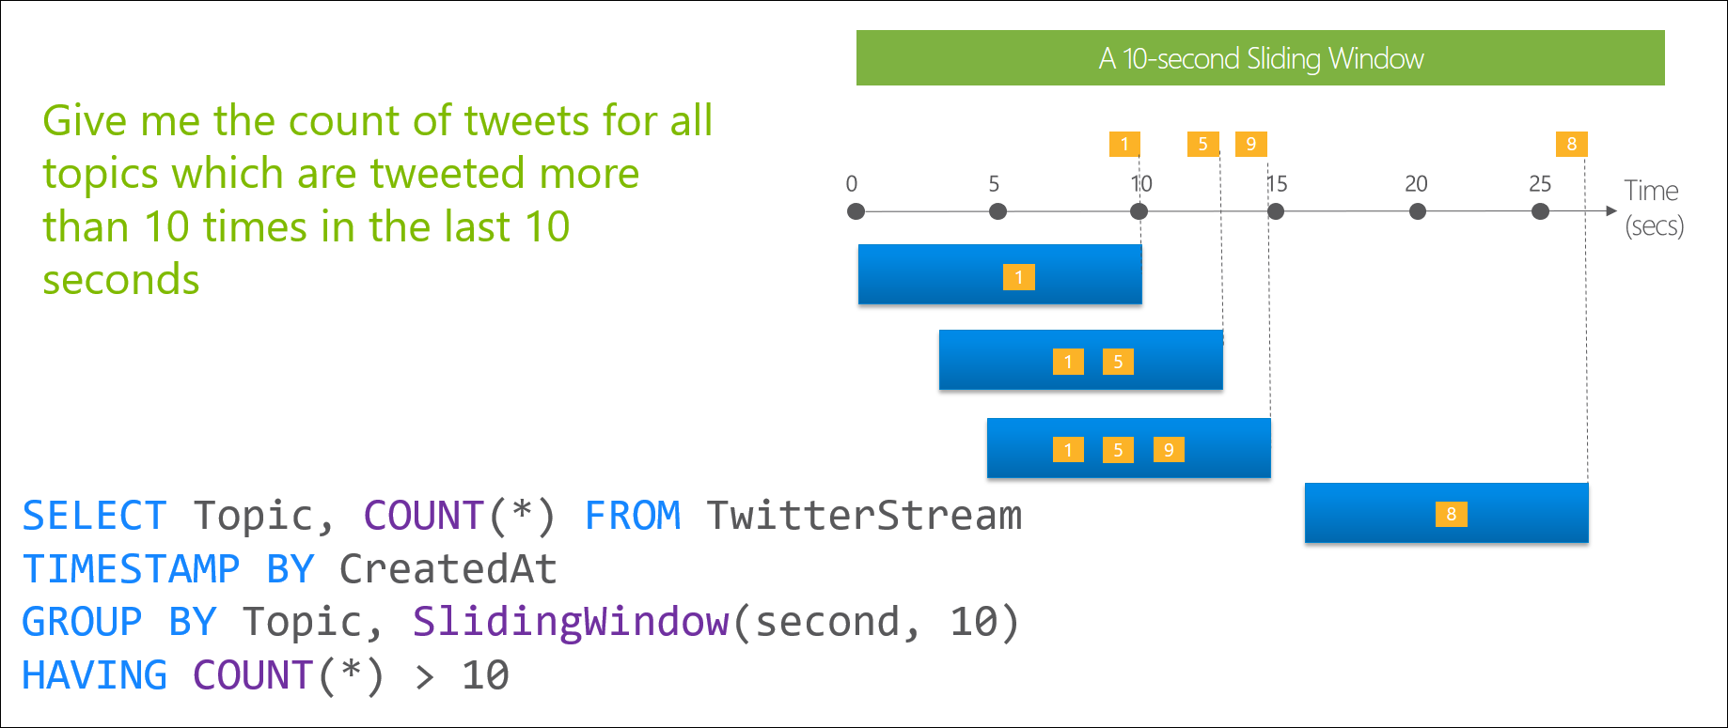
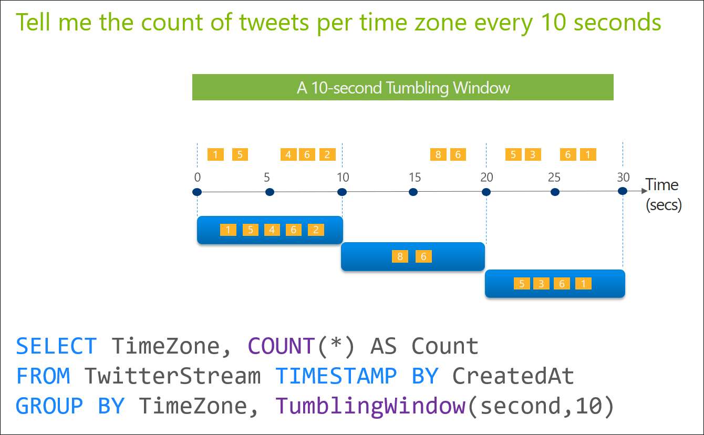
Windowing Functions
Sliding Windows and Tumbling Windows
Sliding Windows
Tumbling Windows

Slide 106
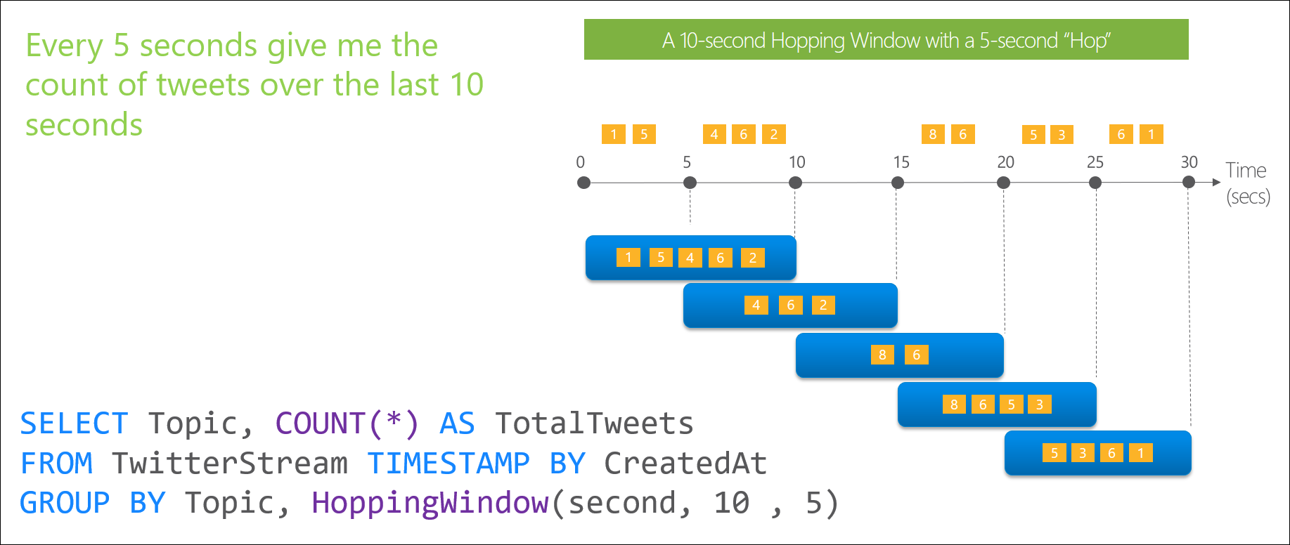
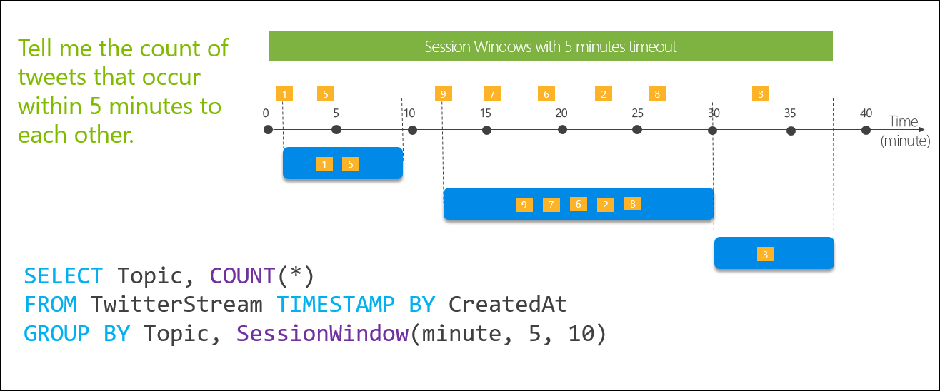
Windowing Functions
Hopping Windows and Session Windows
Hopping Windows
Session Windows

Slide 107
Lab 5: Ingest and Analyse real-time data with Event Hubs and Stream Analytics

Slide 108
Lab 5
Stream

Slide 109
Lab 5
Lab Architecture

Slide 110
It’s all on
Notes:
With Azure, you can be more productive. Azure has more than 100 services with great end-to-end tools to make you successful.
Develop and deploy where you want, with the only consistent hybrid cloud on the market. Extend Azure on-premises with Azure Stack.
Create intelligent apps using powerful data and AI services.
Develop with confidence on the trusted cloud.
<Transition>: Join startups, governments, and 90% of Fortune 500 businesses who run on the Microsoft Cloud today.

